Slide 1
Computer Architecture Overview
STA 308 - Day 03

Slide 2
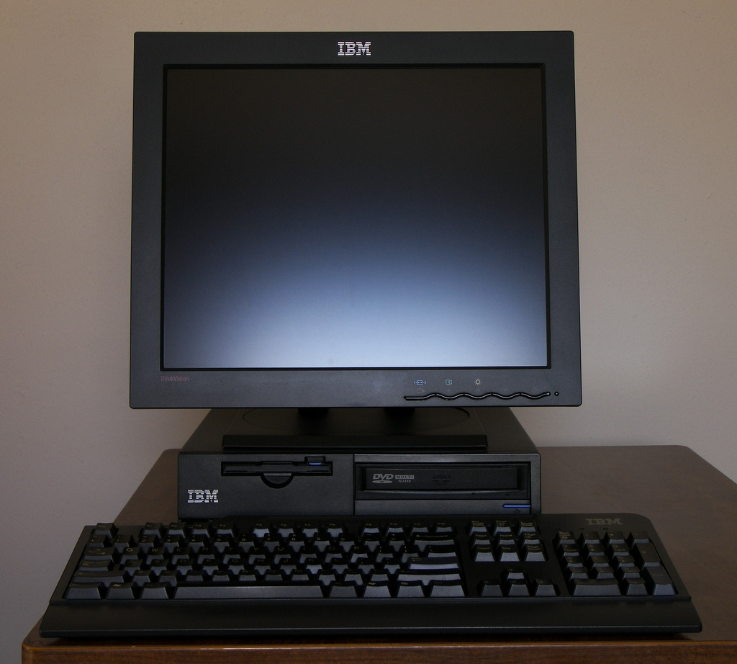
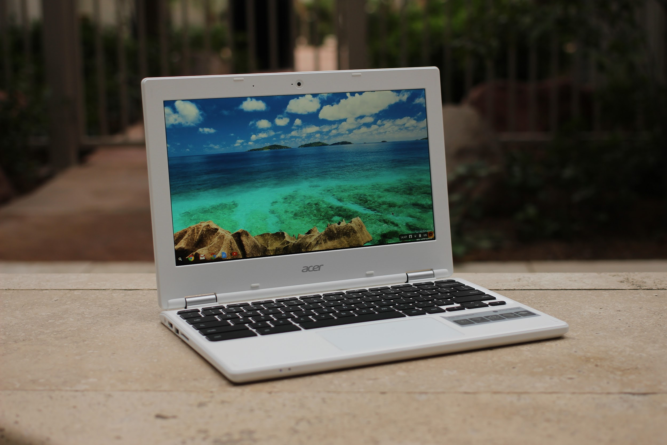
Images from wikipedia
What you think when you hear “computer”
Notes:
Common language use of the word “Computer”

Slide 3
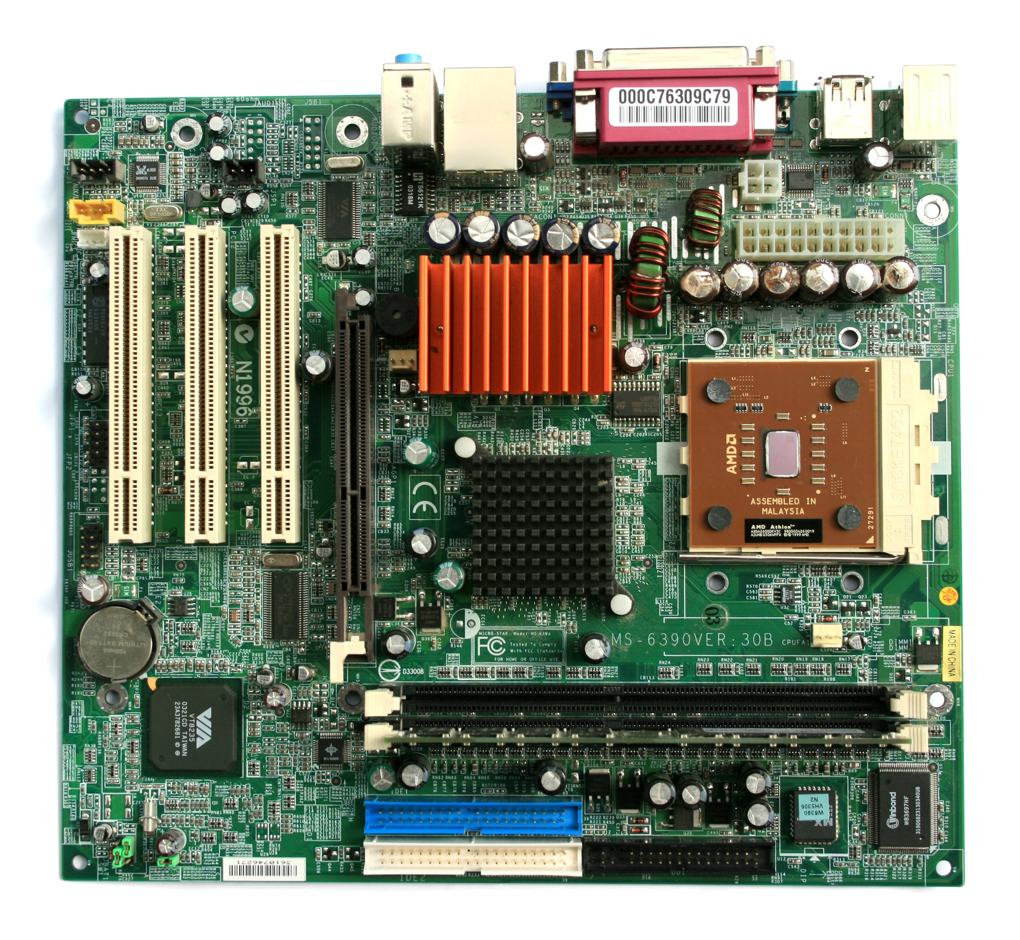
The actual “computer”
Highlighted is the machine that does the computing!
Central Processing Unit (CPU)
The “Processor”
Logic Control Units
Math co-processors
Random Access Memory (RAM)
Memory for the CPU
Image of motherboard from wikipedia
Notes:
The actual part that computes!

Slide 4
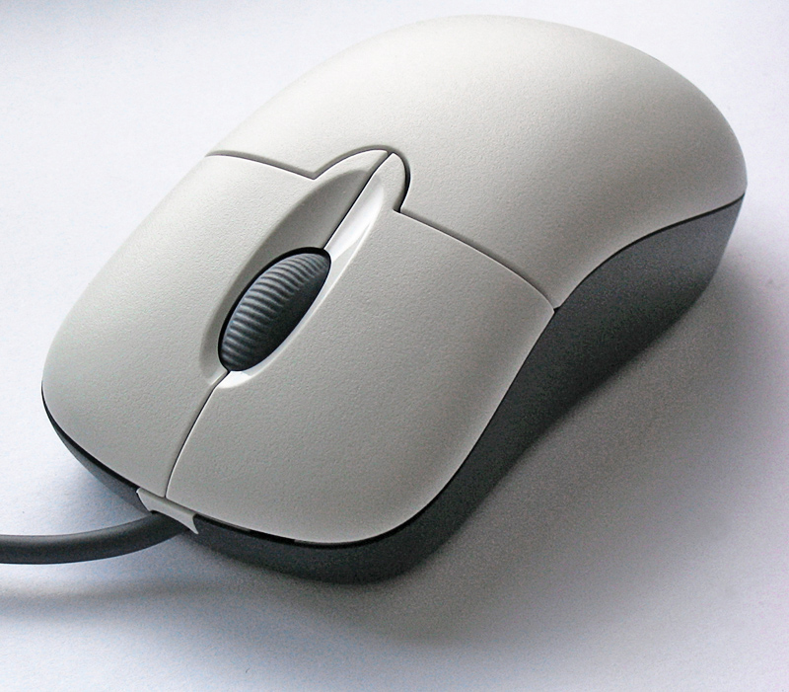
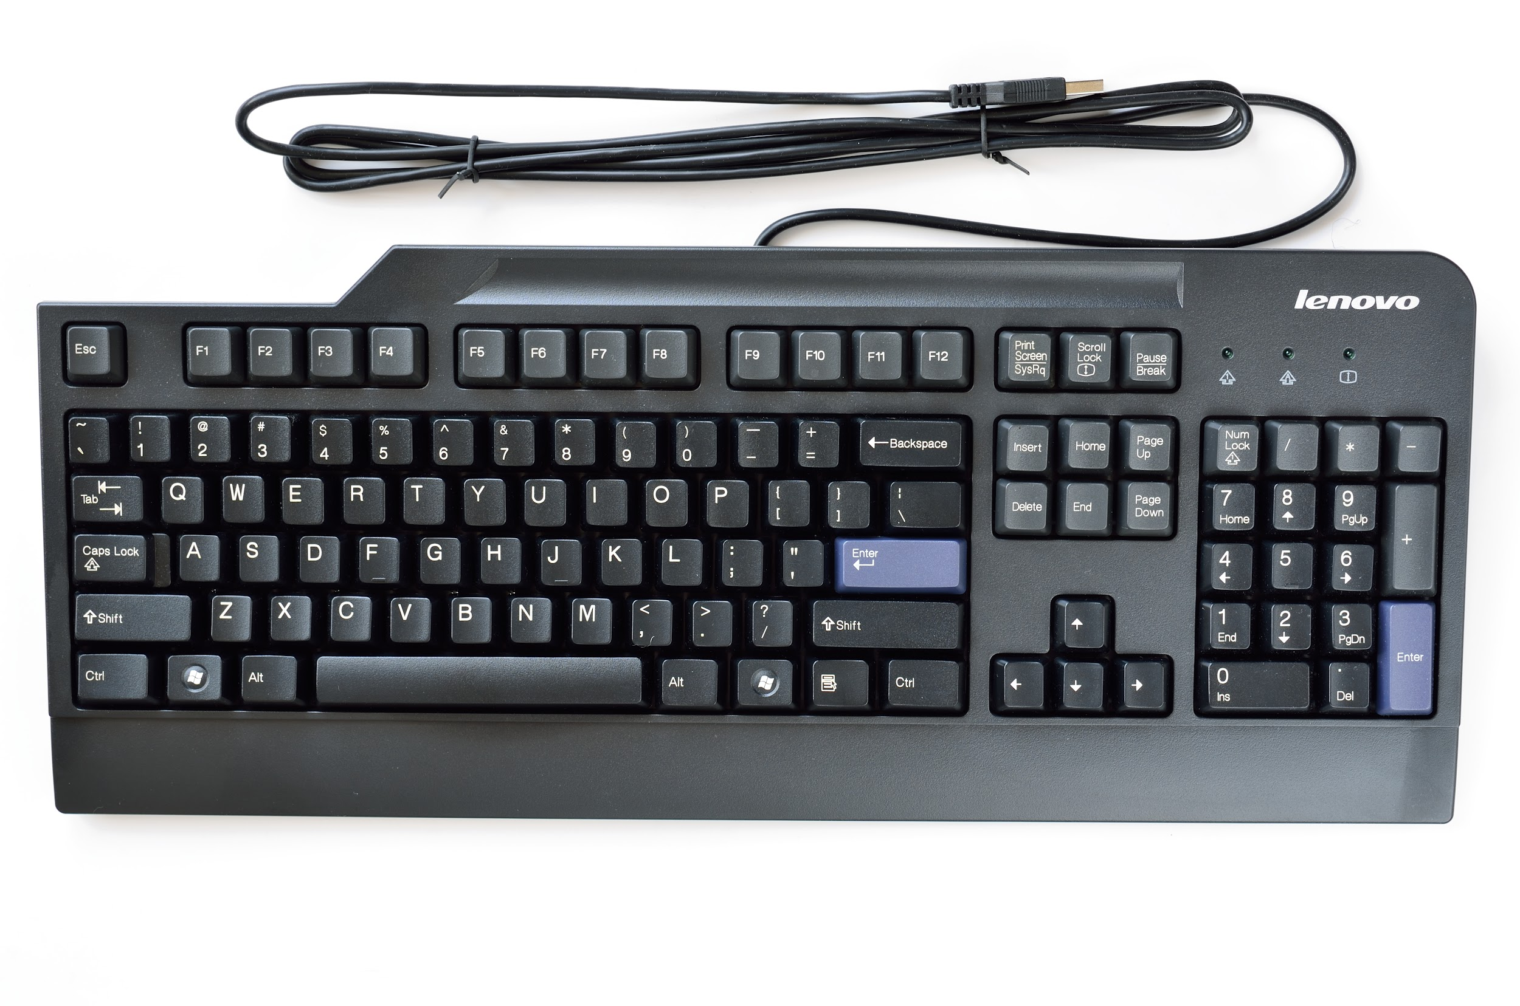
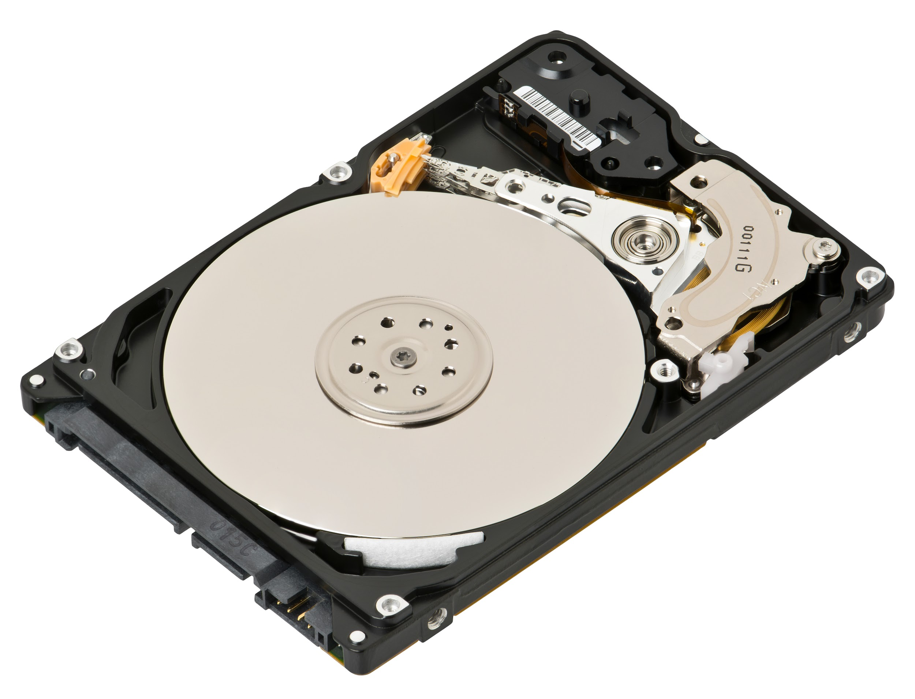
“Inputs”
Images from wikipedia
Notes:
Inputs to interact with the internal computer

Slide 5
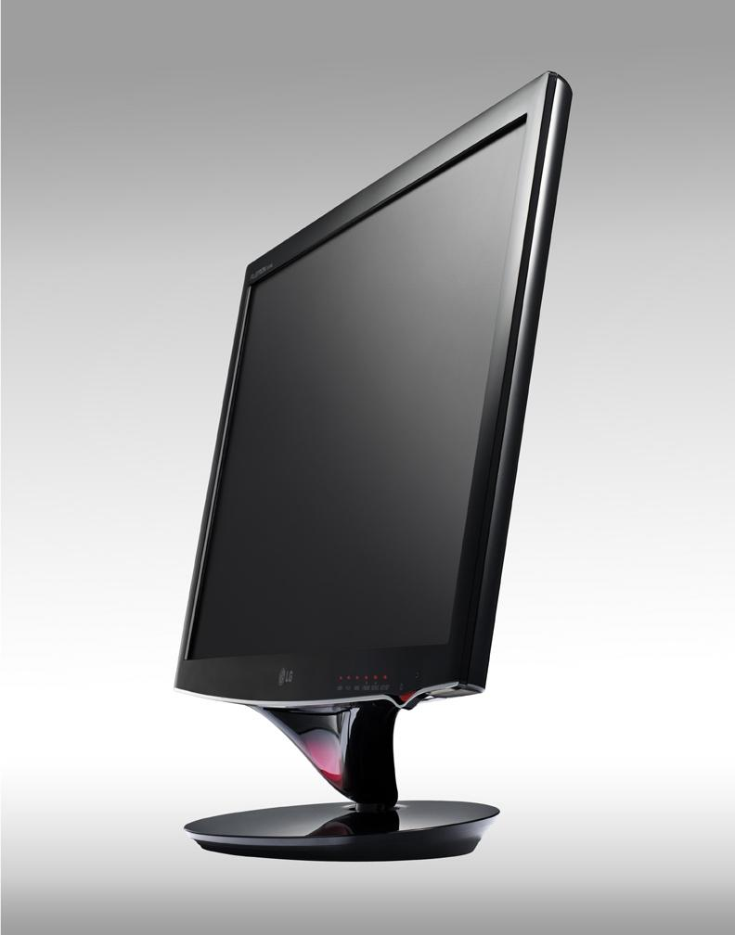
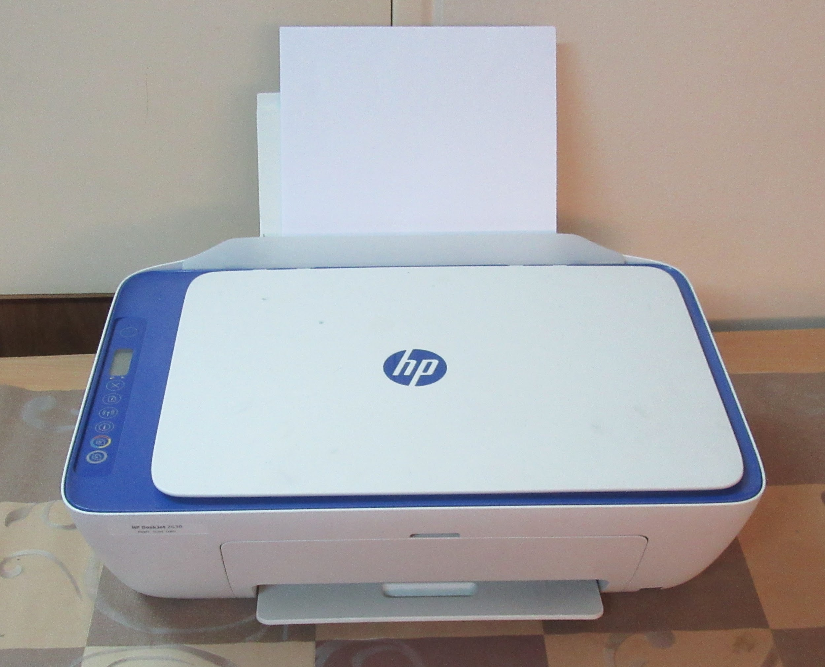
“Outputs”
Images from wikipedia
Notes:
Outputs from the computer

Slide 6
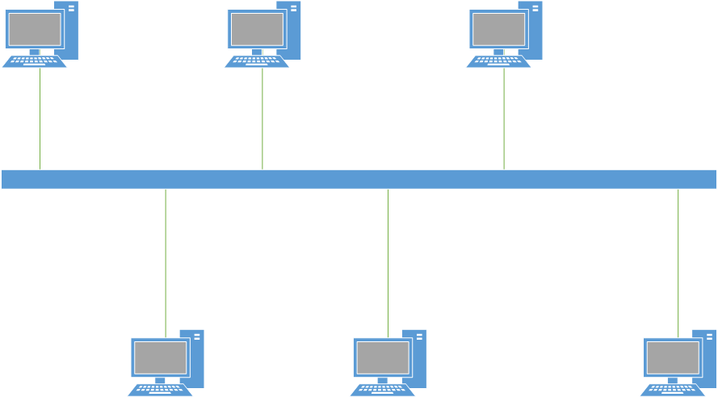
Computers are often “networked”
Image from wikipedia
Notes:
Computer may be connected through a network -- the network can operate as an input device and an output device

Slide 7
Basic Computer Architecture
The Computer
Inputs
Keyboard
Mouse
Storage device
Punch card
Network data
Processor
Central Processing Unit (CPU)
Outputs
Monitor
Printer
Storage device
Networks
Memory
Random Access Memory (RAM)
Notes:
This diagram helps show how a computer works
Instructions are input, stored in memory, the CPU takes the info in memory & processes, stores the result/outcome in memory, it may then be output

